Slide 1

HFS File System Fundamentals
Understanding the foundations of macOS file system architecture for digital investigation

Slide 2

Evolution of Hierarchical File Systems
1
HFS (1985)
Original hierarchical file system
16-bit allocation blocks
Limited scalability
2
HFS+ (1998)
Extended file system
32-bit allocation blocks
Unicode support, journaling
3
APFS (2017)
Modern successor
64-bit architecture
Optimised for flash storage
Forensic relevance: Legacy HFS volumes still encountered in older macOS investigations and historical evidence recovery

Slide 3
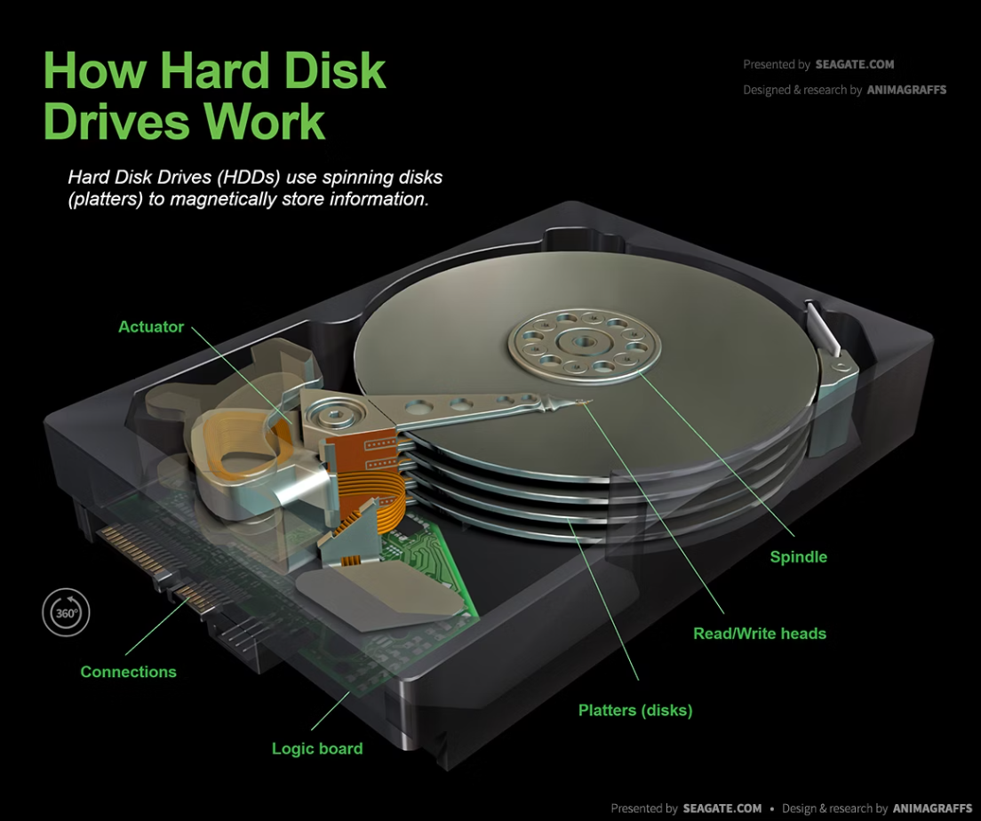

HFS+ Partition Architecture
Core Components
01
Volume Header
Boot blocks, volume metadata
02
Allocation File
Tracks used/free blocks
03
Catalog File
Directory structure, file records
04
Extents Overflow
Critical insight: Journal file preserves recently deleted file metadata—valuable for timeline reconstruction
Fragmented file locations
05
Attributes File
Extended metadata storage
06
Journal File
Transaction logging (HFS+ only)

Slide 4

Metadata Structures & B-Trees
B-Tree Organisation
Catalog Records
Balanced tree structure for efficient searching
File records: metadata, data fork locations
Header node → Index nodes → Leaf nodes
Folder records: directory hierarchy
Thread records: reverse lookups
Stores catalog and extents data
Extent Records
Map file data to physical blocks
Handle file fragmentation
Critical for file reconstruction
Special metadata blocks: Volume bitmap, startup file, and alternate volume header provide redundancy and recovery options

Slide 5


Critical Artefacts for Investigation
File Paths
Complete directory tree reconstruction from catalog
Identify file locations and relationships
Timestamps
Creation, modification, access times
Backup timestamps (HFS+ specific)
File Attributes
Permissions, flags, ownership data
Extended attributes and resource forks
Pro tip: Orphaned catalog records often survive deletion—cross-reference with allocation file to recover deleted file metadata
Orphaned Records
Deleted file catalog entries
Unallocated extent records
Journal transaction evidence

Slide 6
Recreating HFS Partitions
Forensic recovery techniques for damaged or lost HFS file systems

Slide 7
When Partition Recovery Becomes Necessary
Corrupted Structures
Deleted Tables
Hidden Evidence
Volume header or catalog file damage prevents normal mounting and access to filesystem data.
Partition table entries removed either accidentally or deliberately to hide evidence from investigators.
Critical case data may exist in unallocated space or damaged partitions requiring manual reconstruction.

Slide 8

Essential Forensic Recovery Tools
Open Source Solutions
Commercial & Platform Tools
TestDisk - Automated partition detection and recovery
EnCase - Enterprise forensic suite
Sleuth Kit - Command-line utilities (fsstat, fls, icat, blkls)
FTK - Forensic Toolkit for evidence processing
Disk Utility - macOS native logs and diagnostics
Autopsy - GUI-based forensic analysis platform
Disk Arbitrator - Mac partition control utility

Slide 9
Six-Step Reconstruction Methodology
01
02
Identify Partition Boundaries
Locate Volume Headers
Scan disk sectors to locate partition start and end points using signature analysis.
Find primary volume header at offset 1024 bytes and backup header in final sectors.
03
04
Carve HFS Structures
Rebuild Catalog File
Extract allocation bitmap, extents overflow file, and attributes file from known offsets.
Reconstruct B-tree structure containing all file and folder metadata records.
05
06
Reconstruct Directory Tree
Validate Recovered Data
Map parent-child relationships using Catalog Node IDs to recreate folder hierarchy.
Verify file integrity through hash comparison and structure consistency checks.

Slide 10
Key Takeaways
Multiple Recovery Paths
Structured Approach Required
Documentation Critical
Combine automated tools like TestDisk with manual techniques for maximum evidence recovery success.
Maintain detailed logs of all recovery steps and tool outputs for court admissibility and peer review.
Follow systematic methodology from boundary identification through validation to ensure forensic soundness.

Slide 11

Analyzing Unallocated Space in Forensics
Uncovering hidden evidence in the unused sectors of macOS storage systems

Slide 12
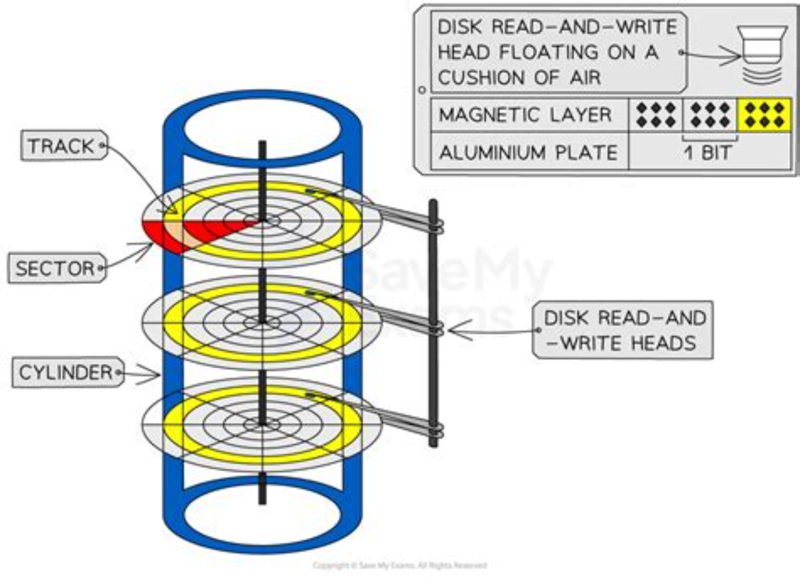

Understanding Unallocated Space
Definition
Unused disk sectors not currently allocated to active files or file systems
Key Components
Deleted file remnants
File slack space
Residual data fragments
Overwritten blocks
Forensic Value: Unallocated space often contains critical evidence that users believed was permanently deleted

Slide 13
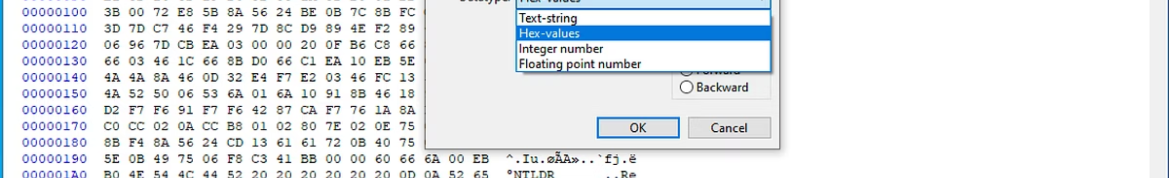








Types of Unallocated Data Artifacts
Deleted File Remnants
Residual Fragments
Complete or partial files removed by user actions but not yet overwritten
Data chunks from previous file operations, partial overwrites, or file truncation
Header/Footer Artifacts
Overwritten Blocks
File signatures enabling identification: JPEG (FF D8), PDF (25 50 44 46), ZIP (50 4B)
Sectors reused by file system; non-overwritten blocks retain original data

Slide 14
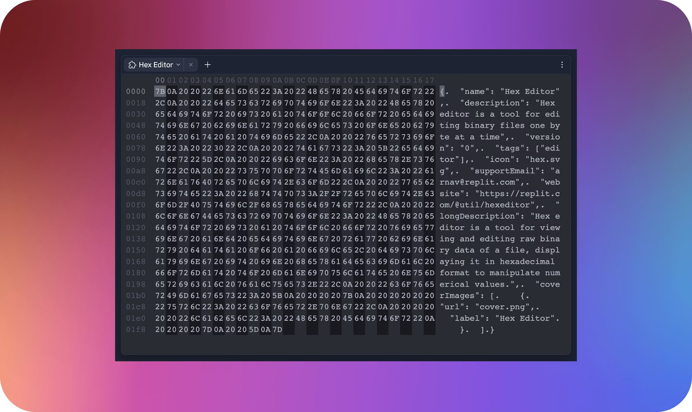

Forensic Analysis Techniques
01
02
Hex-Level Examination
File Carving
Raw sector analysis to identify file structures, magic numbers, and data patterns at byte level
Metadata-independent recovery using header/footer signatures to reconstruct files from fragments
03
04
Signature Searching
Pattern Matching
Automated scanning for known file type markers: JPEG, PDF, ZIP, PLIST, system logs
Keyword searches, regular expressions, and entropy analysis to locate relevant evidence
Best Practice: Combine multiple techniques to maximize data recovery and validation accuracy

Slide 15






Tools & Documentation
Essential Forensic Tools
Presenting Findings
1
Document Recovery Process
Scalpel / PhotoRec
Chain of custody, tool versions, extraction timestamps, sector locations
Open-source file carving utilities for signature-based recovery
2
Validate Carved Data
Verify file integrity, cross-reference with metadata, hash validation
Autopsy / Sleuth Kit
3
Demonstrate Evidentiary Value
blkls for block extraction, strings command for text analysis
Contextualize findings within investigation scope, maintain audit trail
Magnet Axiom / EnCase
Commercial platforms with advanced carving algorithms and reporting
Bulk Extractor
Specialized tool for extracting emails, URLs, credit cards from raw data

Slide 16
THANKYOU

